Slide 1
Unit 4 Simplification 0f Boolean Function

Slide 2
Venn diagram
It is used to visualize the relationship among the variables of Boolean expression.
NOT: Complement ( ' )
AND: Intersection (∩)
OR: Union (∪)

Slide 3
Venn Diagram

Slide 6
Boolean expression and Boolean function
Boolean expression can be represented in two standard forms:
Sum of Product(SOP) form
Product of Sum(POS) form

Slide 7
Sum of Product(SOP) form:
SOP is two or more product terms ( ANDed terms ) summed (ORed)together.
can have a term with a single variable.
0 represents Ā and 1 represents A.
Only 1's output is taken. Ex: F=A+ ĀB ;F=ABC+ ĀBC+BC
Standard SOP:
all the variables appear in each product term of the expression. F= AB + B C + Ā D is not standard SOP. F=ĀBCD + ABCD + Ā BCD is standard SOP.
Each individual product term in standard SOP form is called minterm and is represented by 'm'.

Slide 8
Min terms for three variables (A, B, C)

Slide 9
Example
 | Input |  |  |  |  | Function output
A |  |  | B |  | C | F₁ | F₂
0 |  |  | 0 |  | 0 | 1 | 0
0 |  |  | 0 |  | 1 | 1 | 1
0 |  |  | 1 |  | 0 | 0 | 0
0 |  |  | 1 |  | 1 | 0 | 1
1 |  |  | 0 |  | 0 | 0 | 0
1 |  |  | 0 |  | 1 | 1 | 1
1 |  |  | 1 |  | 0 | 1 | 0
1 |  |  | 1 |  | 1 | 0 | 1
F1=A'B'C'+A'B'C+AB'C+ABC'=m₀ + m₁ + m₅ +m₆
=∑m(0,1,5,6)
F2=A'B'C+A'BC+AB'C+ABC=m₁ + m₃ + m₅ +m₇
=∑m(1,3,5,7)

Slide 10
Converting SOP to Standard SOP:
Multiply each product term by (A + A' ) where A is the missing term.
Expand the multiplication and repeat step 1 until standard SOP is obtained.
EXAMPLE: Convert A + AB' + B' C to standard SOP.
A + AB' + B' C
= A(B + B') (C + C') + AB' (C + C') + B'C(A + A')
= (AB +AB' ) (C +C') +AB'C + AB'C'+AB'C + A'B'C
= ABC + ABC'+ AB'C +AB'C'+AB'C+ AB'C'+ AB'C +A'B'C
= ABC + ABC'+ AB'C + AB'C'+ A'B'C
Convert A+B'C in to canonical form.
Convert A+B'C in to standard min term.

Slide 11
Product–of–sums form (POS)
two or more sum terms are multiplied together.
AND function of two or more ORed functions.
In POS representation, 0 represents A and 1 represents A'.
only 0's output is taken.
can also contain a single variable terms.
Ex: A' (B +C') (B + C)
Standard POS
all the variables appear in each sum term in the expression.
A (B'+C')(A+C) is not standard POS.
(A+ B'+ C) (A'+ B'+ C') is standard POS.
Each individual sum term in standard POS form is called “maxterm” and is represented by 'M'.

Slide 12
Maxterm of three variables
A |  | B | C | Term |  |  |  | Designation (M_{j})
0 | 0 |  | 0 | A+B+C |  |  |  | M₀
0 | 0 |  | 1 |  |  |  |  | M₁
 |  |  |  | A+B+C'
0 | 1 |  | 0 |  |  |  |  | M₂
 |  |  |  | A+B'+C
0 | 1 |  | 1 |  |  |  |  | M₃
 |  |  |  | A+B'+C'
1 | 0 |  | 0 |  |  |  |  | M₄
 |  |  |  | A'+B+C
1 | 0 |  | 1 |  |  |  |  | M₅
 |  |  |  | A'+B+C'
1 | 1 |  | 0 |  |  |  |  | M₆
 |  |  |  | A'+B'+C
1 | 1 |  | 1 |  |  |  |  | M₇
 |  |  |  | A'+B'+C'

Slide 13
Example
F1=(A+B'+C)(A+B'+C')(A'+B+C)(A'+B'+C')=M₂ . M₃ . M₄ .M₇
=∏M(2,3,4,7)
F2=(A+B+C)(A+B'+C)(A'+B+C)(A'+B'+C)=M₀. M₂ .M₄ .M₆
= ∏M(0,2,4,6)
 | Input |  |  |  |  | Function output
A |  |  | B |  | C | F₁ | F₂
0 |  |  | 0 |  | 0 | 1 | 0
0 |  |  | 0 |  | 1 | 1 | 1
0 |  |  | 1 |  | 0 | 0 | 0
0 |  |  | 1 |  | 1 | 0 | 1
1 |  |  | 0 |  | 0 | 0 | 0
1 |  |  | 0 |  | 1 | 1 | 1
1 |  |  | 1 |  | 0 | 1 | 0
1 |  |  | 1 |  | 1 | 0 | 1

Slide 14
Converting POS to standard POS:
Add A. A' to each sum term, where A is missing term.
Apply rule A + BC = (A + B ) ( A + C)
A. A = A
Repeat step 1 to 3 until standard POS is obtained.
EXAMPLE:
Convert (A + B' + C) (B' +C + D)
(A + B' + C) (B– + C +D)
= (A + B'+ C+ D.D')(B'+C+D+A. A')
=(A+B'+C+D)(A+ B'+ C+D')(A+ B'+ C+ D)(A'+B'+C+D)
=(A +B'+ C+D)(A+ B'+C+D')(A'+B'+C+D)

Slide 15
Relationship between min terms and max terms:
m_{i} = M_{j}
Each max term is the complement of its min term and vice versa.

Slide 16
Karnaugh Map (K-map)
graphical chart and a pictorial form of truth table.
used to simplify the Boolean equations.
for n variables, there are 2^{n} squares arranged in specific order. For 2 variables, there are 2² = 4 cells in K-map 3 variables, there are 2³ = 8 cells in K-map 4 variables, there are 2⁴ =16 cells in K-map n variables, there are 2^{n} = 2n cells in K-map.

Slide 17
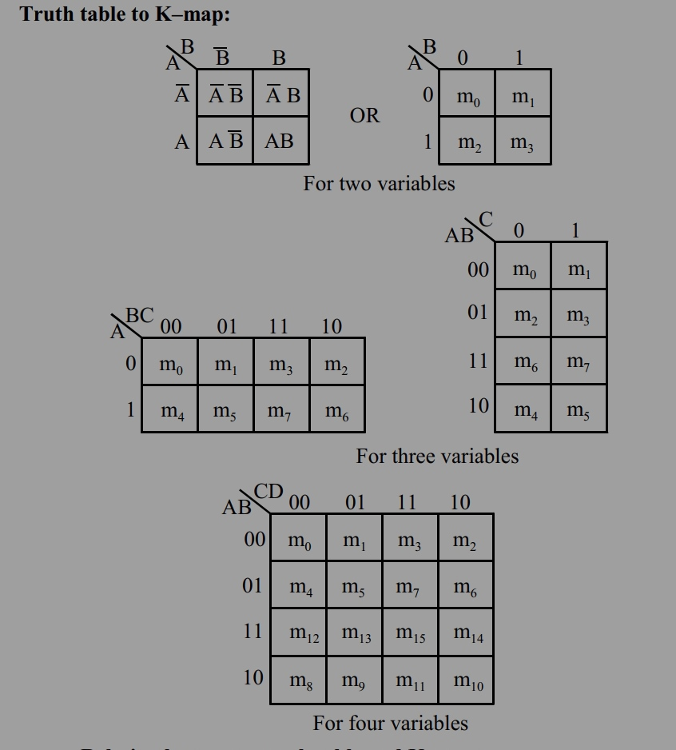

Slide 18
Simplification procedure
1. Plotting 2. Grouping 3. Simplification
1.Plotting
Plot 1, if the given expression is SOP
Plot 0, if the given expression is POS.
2. Grouping techniques
group adjacent cells only.
number of 1s or 0s should be in 2^{n} numbers. 2⁰ = 1 (isolated term) 2¹ = 2 (pair) 2² = 4 (quad) 2³ = 8 (octet) 2⁴= 16 (hex)
3. For Simplification , we should group the hex first, octets second, the quads third, and the pairs last.

Slide 19
Adjacent cells
Overlapping groups
Redundant groups
If all the 1s in a group are already involved in some other group, then that group is called redundant group. It has to be eliminated, because it increases the number of gates required.

Slide 20
Don't care condition
is the condition of input which doesn't affect output.
Plot 1s to the combination of input variables for SOP form which produces a high output.
Plot 0s to the combination of input variables for POS form which produces a low output
is represented as ' X ' (cross) mark in corresponding cells.
Don't care condition may be assumed to be 0 or 1 as per the requirement for simplification.

Slide 21
Simplification of SOP expression using K-map Simplification of POS expression using K-map

Slide 22
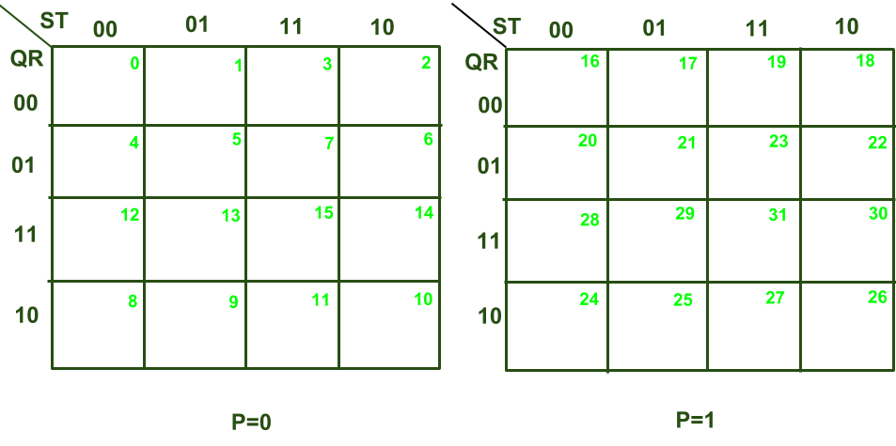
5 variables K map
F(P, Q, R, S, T)

Slide 23
END OF UNIT 4

